Slide 7
The Faculty Lounge
Ms. Smith (the school principal) just won the lottery and abruptly left our back to school meeting. She said, "I'm outta here! If you need me, I'll be on my newly purchased private island near Fiji without my cell phone or access to email. everything you will need for another great year is in this room. Good luck!"
You look around and find a newly printed school handbook as well as a locked box which you hope will hold the key to a successful school year ahead.
The students show up in 45 minutes. Can you be ready by then?

Slide 8
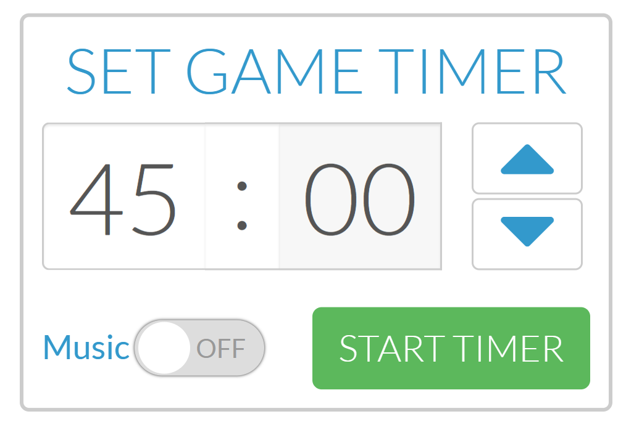
Your 45 Minutes Begins Now!

Slide 9
